Slide 1
Let’s Do It Creatively: For The Benefit of Adult Learners
A Grundtvig Learning Partnership
Prepared by Kevin Harrington
Co. Dublin VEC

Slide 2
Background to Project
Result of a contact seminar in Malta in December 2008
Project proposal submitted in February 2009
Project approved in Summer 2009

Slide 3
The Partners
Ireland: County Dublin Vocational Education Committee (Co-ordinator)
Portugal: Arte-Via Cooperativa Artística e Editorial
Romania: Universitatea Spiru Haret Bucuresti – CTID Ploesti
Czech Republic: Palacký University Olomouc – Faculty of Natural Sciences
United Kingdom: Joanna Pinewood Education Limited
Spain: Centro de Educación de Adultos, Caceres
Germany: Akademie 2. Lebenshälfte im Land Brandengurg e.V.
Malta: MacDAC Engineering Consultancy Bureau (MECB) LTD
Turkey: Andirin Halk Egitimi Merkezi
Malta: Office of the College Principal, Saint Theresa College

Slide 4
Objective 1
To develop and share creative and innovative methods to engage learners so that they will develop the ‘key competences’ all individuals need for personal fulfilment and development, inclusion and employment.

Slide 5
Objective 1 (Ctd.)
These key competences are:
Communication in the mother tongue
Communication in foreign languages
Competences in maths, science and technology
Digital competence
Learning to learn
Interpersonal, intercultural and social competences, and civic competence
Entrepreneurship
Cultural expression

Slide 6
Objective 2
To encourage teachers to see themselves as facilitators in the learning process rather than just subject experts who disseminate knowledge

Slide 7
Objective 3
To encourage the development of a ‘joyful’ learning atmosphere

Slide 8
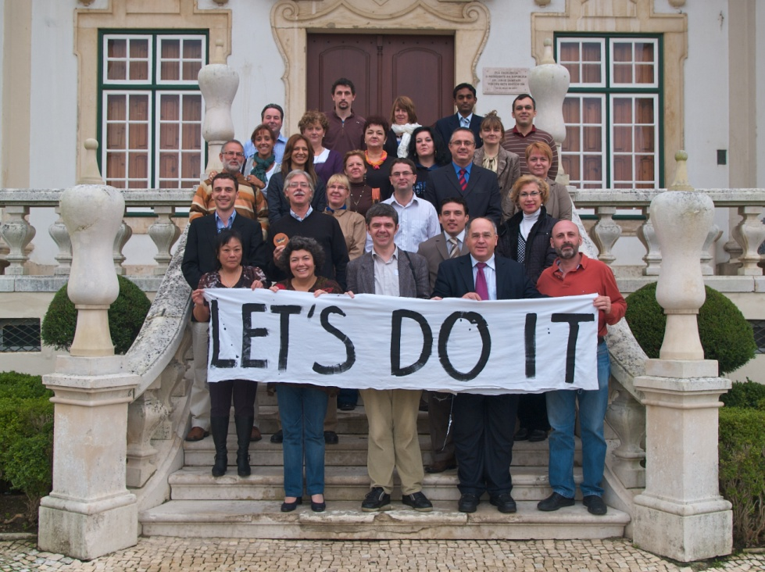
Progress So Far
Met in Portugal in November 2009.
This was a planning meeting to:
Team-build
Fine-tune the project
Set targets: develop a “roadmap” for the project
Quality control
Have launched website: http://letsdoit.upol.cz

Slide 9
Workshops
Location | Date | Focus
Malta | April 2011 | Digital skills, Entrepreneurship
Czech Republic | October 2010 | Competences in maths, science and technology
Romania | March 2011 | Digital Skills Learning to Learn Foreign Languages
Ireland | June 2011 | Interpersonal, intercultural and social competences, and civic competence Communication in the mother tongue

Slide 10
Questions & Discussion
?

